Slide 1

ADM Milling Ltd
2025 Gender Pay Report

Slide 2
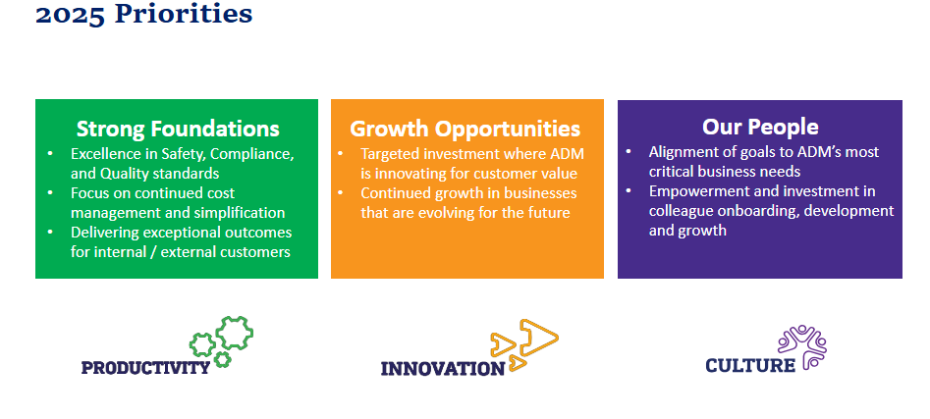
2025 Priorities
Our core values express what we expect of ourselves and each other. They are the foundation for everything we do at ADM.​
Have Integrity​ -Be honest and true.​
Show Respect​ - Treat everyone and everything with
care and consideration.​
Achieve Excellence​ - Be great at what you do and keep getting better.​
Be Resourceful​ - Make it work the right way.​
Practice Teamwork​ - Succeed together.​
Take Responsibility​ - Own it. Do it. Don’t give up.​

Slide 3
ADM’s Culture and Inclusion Vision and Strategy
ADM’s vision is to have an inclusive culture with a diverse workforce where all colleagues globally feel they belong
At ADM we bring together colleagues with many different backgrounds, perspectives and experiences and these global teams drive innovative thinking, growth and diversity of thought.
At ADM we create and maintain a respectful culture in which all colleagues regardless of age, gender, race, ethnicity, national origin, religion, disability, sexual orientation and marital status are included and feel empowered to contribute fully to ADM’s success.
Through the diversity and wide-ranging experience and backgrounds of ADM’s global workforce, we create a competitive advantage; we are actively building a global talent base to support strategic growth, to embrace technology, and to relate to the consumer of the future.
Our Leadership Behaviors
Whether we lead people or projects, we all have the ability to make a positive impact on our culture by setting an example and modeling these behaviors.
We are owners.
We continuously learn.
We help each other thrive.
We create a safe and inclusive environment.
We act with integrity.

Slide 4

Gender Pay Gap Requirements
Since April 2017, organisations with over 250 employees have been required to report annually on their gender pay gap.
The gender pay gap reflects the difference in average hourly earnings between women and men across the workforce, expressed as a percentage of men’s earnings. It provides a high-level view of gender pay balance and workforce representation within an organisation.
The gender pay gap is not the same as equal pay, which is a legal requirement ensuring men and women performing equal work receive equal pay. ADM Milling complies with this legislation.
ADM established its UK Milling operation, ADM Milling LTD, (“ADM Milling”) in 1999. ADM Milling manufactures flour and animal feed and has a head office in Chelmsford, Essex, as well as six wheat flour mills located around the UK, including a Technical Centre in Avonmouth near Bristol, England.

Slide 5
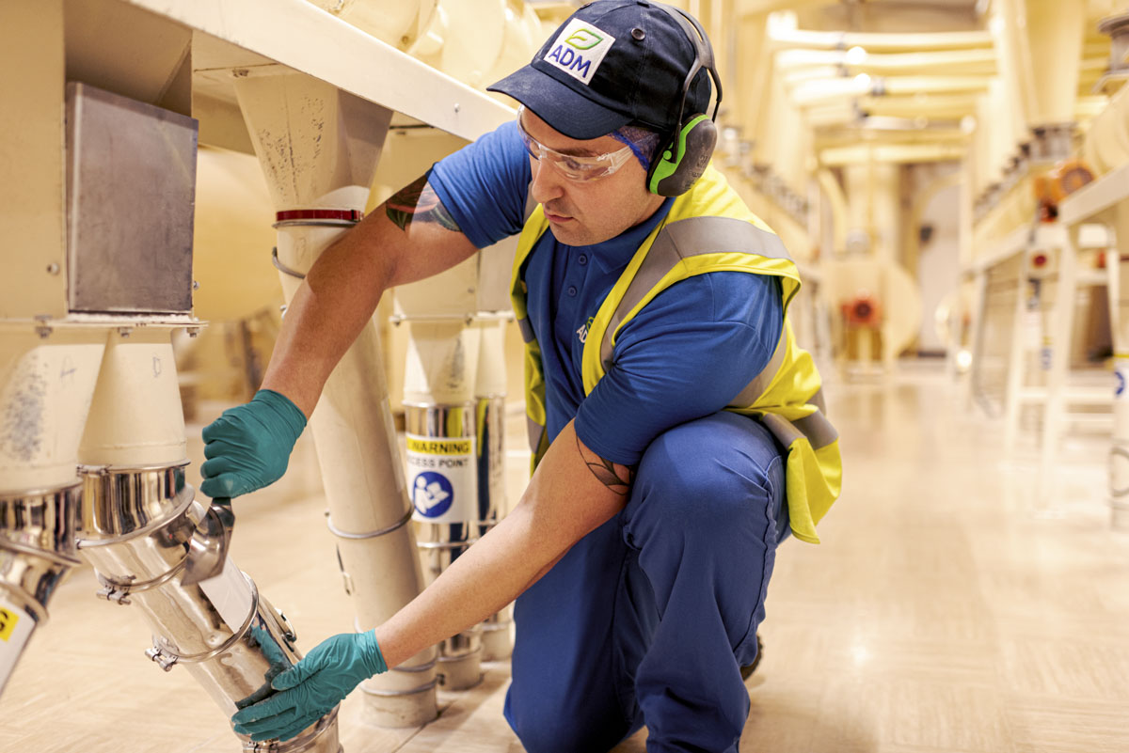
ADM Milling Workforce Demographics
ADM Milling’s workforce is made up of 82% of men and 18% women.
Many operational roles in manufacturing and distribution—such as operators, millers and drivers—are mainly held by men and offer additional earning opportunities through shift allowances and premium payments for additional hours.
While progress has been made in recruiting female drivers and operatives, attracting women to these roles remains challenging. Most female employees work in administrative, support, management and technical roles, which typically offer fewer opportunities to earn beyond base pay.

Slide 6
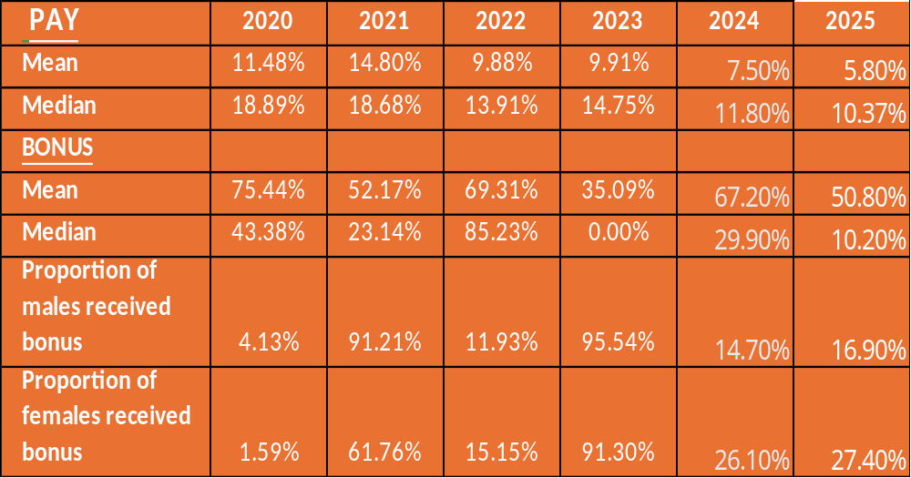

ADM Milling’s Gender Pay Results
Gender Pay Gap
Between 2020 and 2025, ADM Milling has seen a consistent reduction in its gender pay gap. The mean gender pay gap has decreased from 11.48% in 2020 to 5.80% in 2025, while the median gap has reduced from 18.89% to 10.37% over the same period.
This downward trend indicates continued progress in improving pay balance across the organisation.
The difference between the mean and median figures reflects the distribution of roles across the workforce, with a higher proportion of men in senior and operational roles that attract higher levels of pay and additional allowances. This remains a focus for improvement.
The data contained
in this report is
based on a snapshot
date of 5 April 2025.
As of this date ADM
Milling employed
417 people.

Slide 7



ADM Milling’s Gender Pay Results
Gender Bonus Gap
The gender bonus gap has fluctuated year on year, largely due to the relatively small proportion of employees receiving bonuses and variations in eligibility. As a result, bonus gap figures can be more volatile and less representative of overall pay balance.
The proportion of both men and women receiving a bonus has varied across the reporting period. In recent years, there has been an increase in the proportion of female employees receiving bonuses, rising from 1.59% in 2020 to 27.40% in 2025. While bonus gaps remain, this reflects improved access to bonus-eligible roles for women.
Overall, the data demonstrates positive movement in reducing the gender pay gap, with ongoing challenges linked primarily to workforce composition and role distribution.

Slide 8
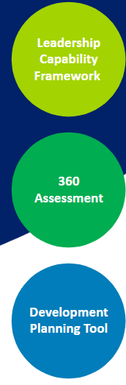




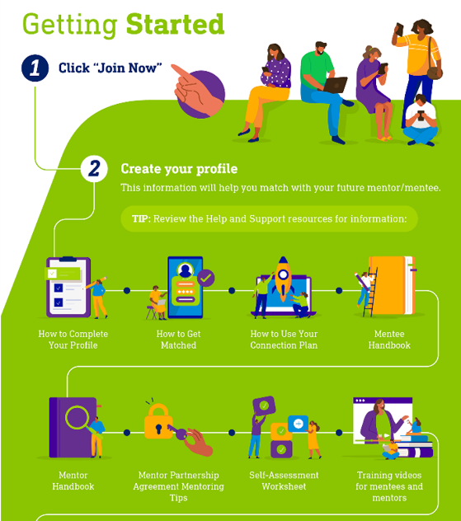



ADM Milling’s Gender Pay Results
Recruit, Develop, Advance, Retain | Culture
Rolled out a Leadership Capability framework with 360 feedback opportunities and use of a development planning tool. | Held 4th Diversity Day – Showing your true colours
Rolled out Leadership Essentials training for Managers, Supervisors and Team leaders | Rolled out our Global employee engagement survey and implemented action plans
Continue to offer and promote LinkedIn Learning and Mentoring opportunities | Rolled out webinars including menopause matters and coping with Grief
Held a Global Week Of Understanding | Ran campaigns such as South Asian Heritage month, Black History month, Pride, International Women’s day, World Mental Health Day
Partnered with The Women's Engineering society to support attract and retain females in engineering | Carried out focus groups to discuss ‘last time an employee felt excluded’. Actions will be determined in 2026
Provided 1-2-1 coaching to achieve a healthy work life balance | Set up a UK Multi Cultural ERG

Slide 9



Men
Women
Pay Quartiles %:
Over the last 4 years the data indicates positive shifts in female representation, particularly in the lower and upper pay quartiles, demonstrating progress is being achieving to support a more balanced workforce structure.
The highest positive changes occurred in the bottom (Quartile 1) and third (Quartile 3) pay quartiles.
  Quartile 1 saw representation grow from 30.30% in 2022 to 31.43% in 2025.
  Quartile 3 showed a strong growth rate, increasing by 3.43% (from 7.14% in 2022 to 10.58% in 2025).
Female representation in the highest-earning bracket, Quartile 4, increased by 2.85% over the four years, rising from 17.35% in 2022 to 20.19% in 2025.
Acknowledging Areas for Further Work
While positive movement is evident, there are areas requiring continued attention:
The most notable area for improvement is Quartile 2, where female representation unfortunately decreased over the period, dropping from 12.24% in 2022 to 7.69% in 2025.
Overall Balance: Despite growth, men continue to hold the majority
of positions across all quartiles, however the data demonstrates a
clear commitment to improving gender balance in key areas, providing a
strong foundation for continued diversity and inclusion initiatives.

Slide 10

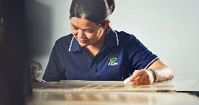

Key Initiatives in 2026:
Our commitment to bridging the gender gap continues as we focus on creating opportunities to cultivate diverse future leaders and empower our colleagues to reach their full potential in their careers at ADM.
FOCUS AREAS FOR 2026 INCLUDE:
Continue to develop our female pipeline through internship programs with the universities we have selected. This is in addition to the graduate and apprenticeship opportunities we provide.
Roll out of management training on key policies and procedures considering the Employment Rights Bill changes.
Host fifth National Diversity Day
Continue to partner with Parent and Professionals to offer a wide range of training, awareness sessions and coaching support for parents and support with the menopause.
Roll out the Step Ahead Program to provide learning opportunities for our talent pipeline.
Continue to partner with our ERGs to support women at all levels across the organisation.
Implement actions derived from the focus group sessions held in 2025, which focused on exclusion.
We will continue to build on the progress we’ve made to close the gender pay gap and to nurture an inclusive, diverse workplace where every colleague feels respected, supported, and that they truly belong.

Slide 11
Menopause Action Plan

Slide 12

Why menopause matters to our gender pay gap?
Why this matters in Society
Why This Matters at ADM Milling
Menopause often occurs during mid-senior career stages, when employees are progressing into senior and higher-paid roles.
Symptoms can impact attendance, performance, confidence and wellbeing, particularly where support or reasonable adjustments are not in place.
Without proactive management, organisations risk:
  Female attrition at mid–senior levels
  Delayed or missed progression and promotion opportunities
  Increased absence and performance management risk.
ADM Milling employs approximately 75 women (18% of the workforce)
Around 26 women are aged 45–55
This age profile represents 35% of our female workforce
Why this is important:
Menopause affects a significant proportion of our workforce at mid–senior career stages. Supporting menopause reflects our values of integrity, respect and excellence, helps retain experienced talent, and supports fair progression, absence and performance management.
The result:
Fewer women in senior, higher-paid roles, reduced lifetime earnings, and a widening gender pay gap.

Slide 13
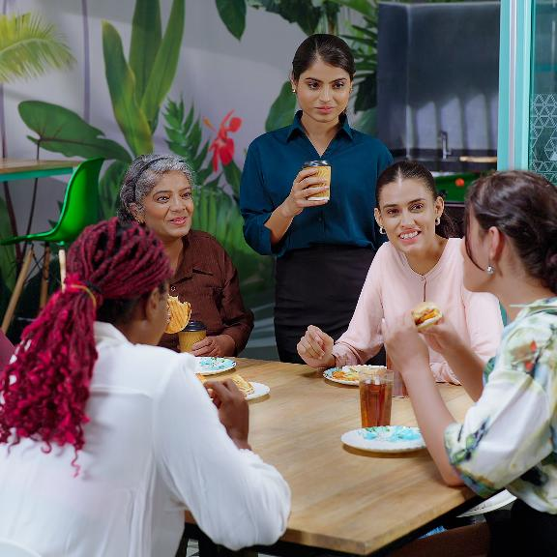
Action taken to Date – Governance & Management Capability
Embedding consistent, fair and effective menopause support
Policy & Framework
  Menopause Policy and Manager’s Guide in place.
  Clear guidance and resources hosted on our parental and menopause portal.
Manager Capability
  Manager training
  1-2-1 Coaching for menopause support
  Practical guidance on absence, performance and reasonable adjustments.
  Risk assessments embedded to support individual needs.

Slide 14
What actions we have taken to reduce barriers and support progression?
Workplace Adjustments
Changed colour of lab uniforms from white to blue following requests from female colleagues
Flexible working and tailored reasonable adjustments
Health & Wellbeing
Occupational Health referrals for specialist advice
Employee Assistance Programme (24/7 confidential support)
GP Anytime and Best Doctors access
Menopause awareness sessions and seminars for women
Bupa menopause appointments with trained menopause nurse for female colleagues
Health Assessments for all colleagues over 50 years old
Provided support for the partners of women dealing with the menopause

Slide 15
Next steps – Strengthening and Sustaining Support
Regular menopause communications to maintain awareness and normalise conversations
Annual recognition and celebration of Menopause Awareness Week
Establishment of a Menopause Champion Network to provide peer support and signposting
Manager refresher training to reinforce confidence in managing absence, performance and reasonable adjustments
Inclusion of menopause guidance within absence, performance and return-to-work conversations
Use of anonymised feedback to inform continuous improvement of menopause support

